Slide 1
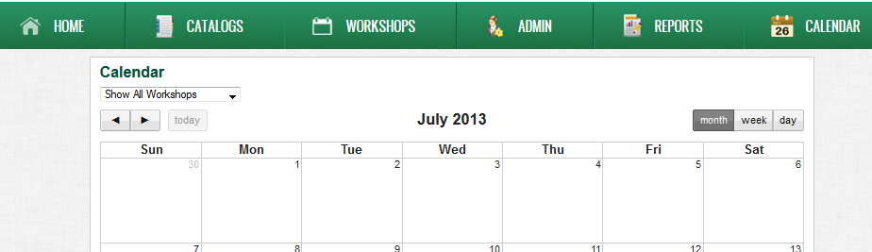
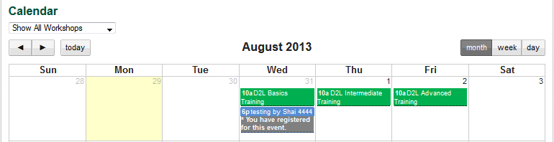
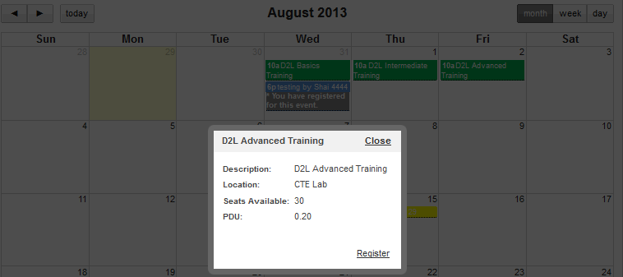
Viewing the event on the Calendar
Click Calendar from the main menu.
Click the arrows to navigate to the date of your workshop (your birthday).
Click on the event.
View the details.
Click Close.
2
1
3
5
4

Slide 2
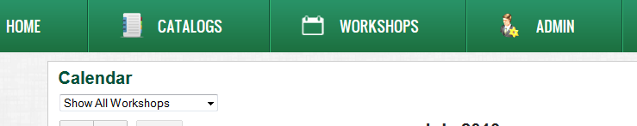
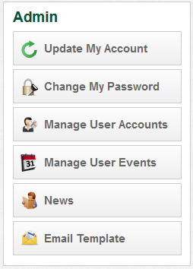
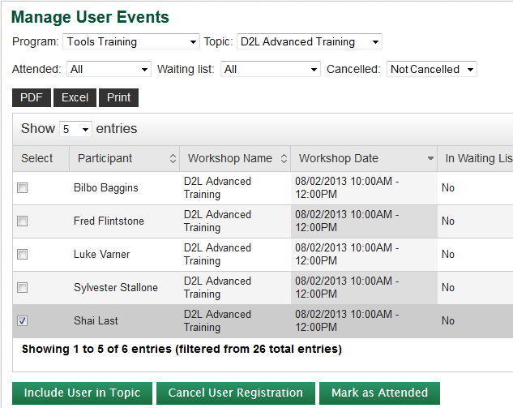
Cancelling Registration by Admin
Click ADMIN from the main menu.
Click Manage User Events from the Admin menu.
Choose Tools Training from the Program drop-down menu.
Choose D2L Advanced Training from the Topic drop-down menu.
Choose Not Cancelled from the Cancelled drop-down menu.
1
2
3
4
5
Continued…

Slide 3
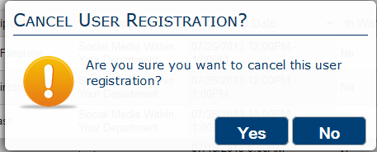
Cancelling Registration by Admin (cont.)
Select the checkbox for a user.
Click the Cancel User Registration button.
Click Yes in the prompt.
6
7
8

Slide 4
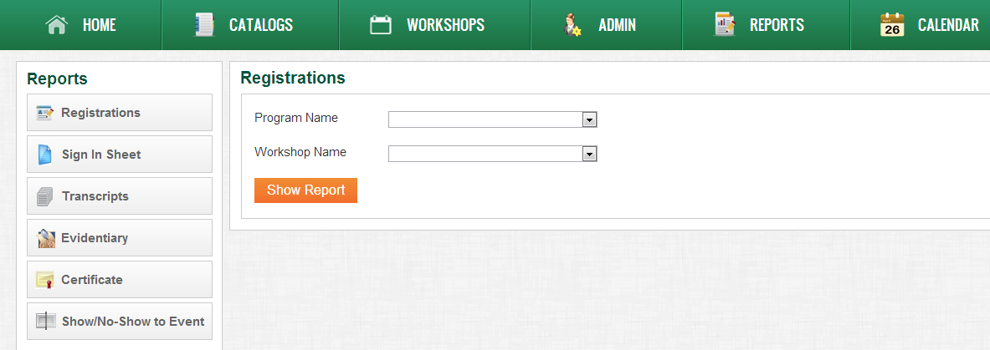
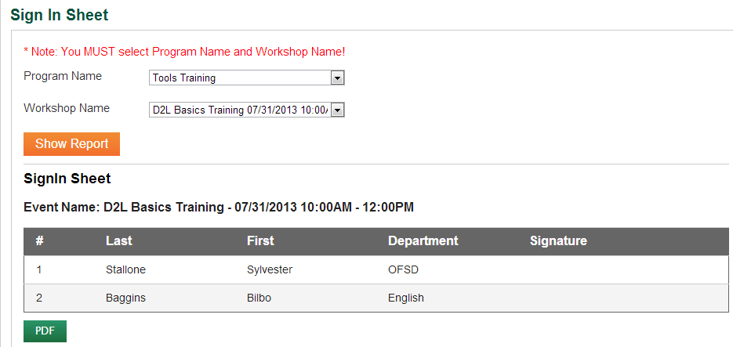
Viewing and Printing Sign In Sheet
Click REPORTS from the main menu.
Select Sign In Sheet from the Reports menu.
Select Tools Training from the Program Name drop-down list.
Select D2L Basics… from the Workshop Name drop-down list.
Click the Show Report button.
Click the PDF button.
Go to your browser’s action bar and select File > Print.
2
1
3
4
5
6

Slide 5
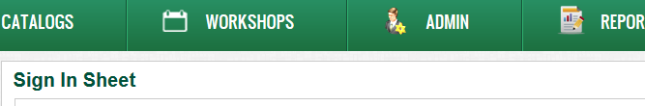
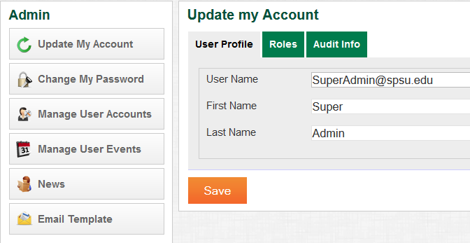
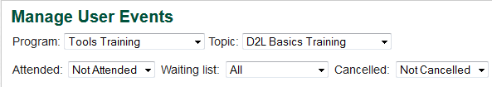
Marking User Attendance
Click ADMIN from the main menu.
Click on Manage User Events from the Admin menu.
Select {Get Name} from the Program drop-down menu.
Select D2L Basics from the Topic drop-down menu.
Select Not attended from the Attended drop-down menu.
Select All from the Waiting List drop-down menu.
Select Not Cancelled from the Cancelled drop-down menu.
1
2
3
4
7
5
6
Continued…

Slide 6
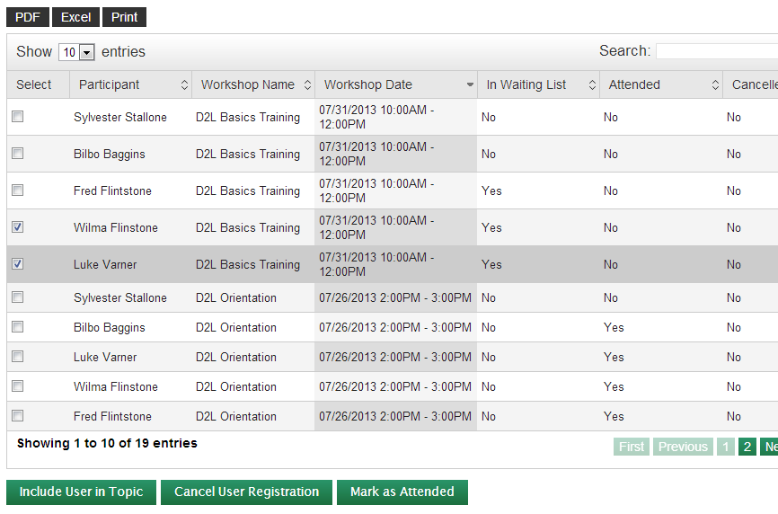
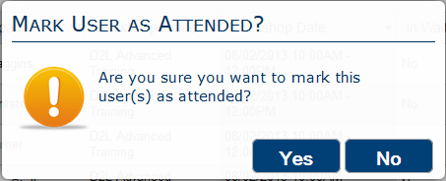
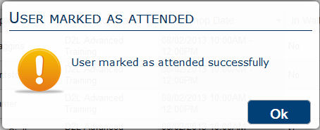
Marking Users Attendance (cont.)
Select the checkbox for the user(s) you want to mark as attended.
Click the Mark as Attended button.
Click the Yes button in the prompt.
Click Ok in the confirmation message window.
8
9
10
11

Slide 7
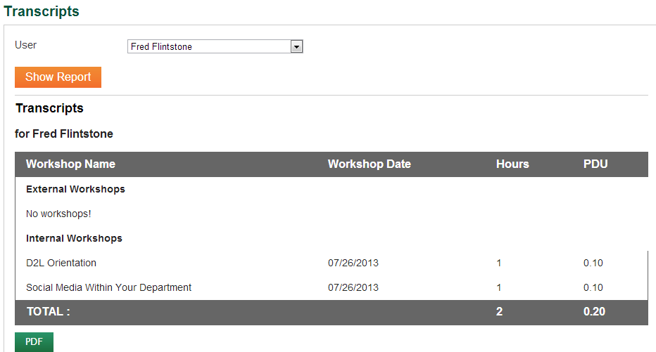
Viewing and Printing Transcripts
Click REPORTS from the main menu.
Select Transcripts from the Reports menu.
Select Fred Flintstone from the User drop-down list.
Click the Show Report button.
Click the PDF button.
Go to your browser’s action bar and select File > Print.
1
2
3
4
5
Notes:
Transcript should be lots of stuff and correct

Slide 8
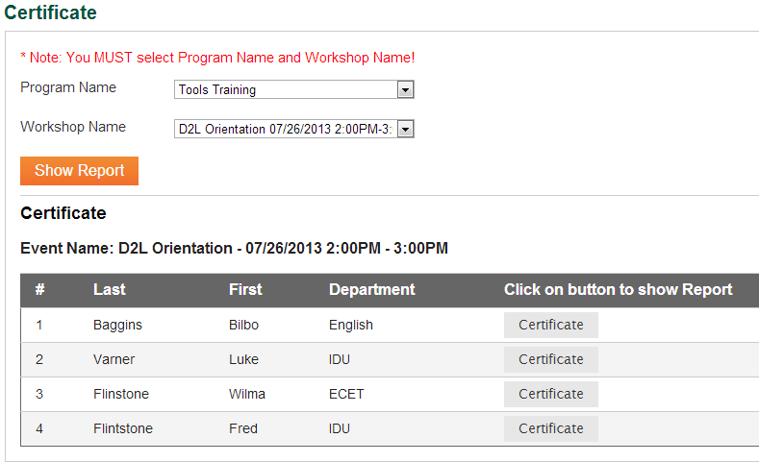
Viewing and Printing Certificates
Click Certificate from the Reports menu.
Choose Tools Training from the Program Name menu.
Choose D2L Orientation … from the Workshop Name menu.
Click the Show Report button.
Click the Certificate button for Fred Flintstone.
Go to your browser’s action bar and select File > Print.
1
2
4
3
5

